Slide 1
CHAPTER : WEB TECHNOLOGY
JavaScript
Jquery
PHP

Slide 2
JavaScript

Slide 3
Output Methods
JavaScript can "display" data in different ways:
➢ Writing into an HTML element, using innerHTML.
➢ Writing into the HTML output using document.write().
➢ Writing into an alert box, using window.alert().
➢ Writing into the browser console, using console.log().

Slide 4
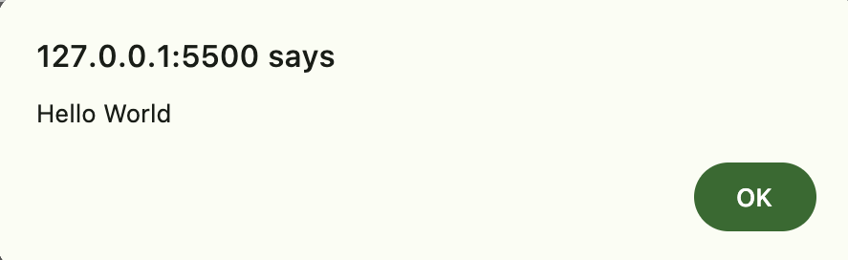
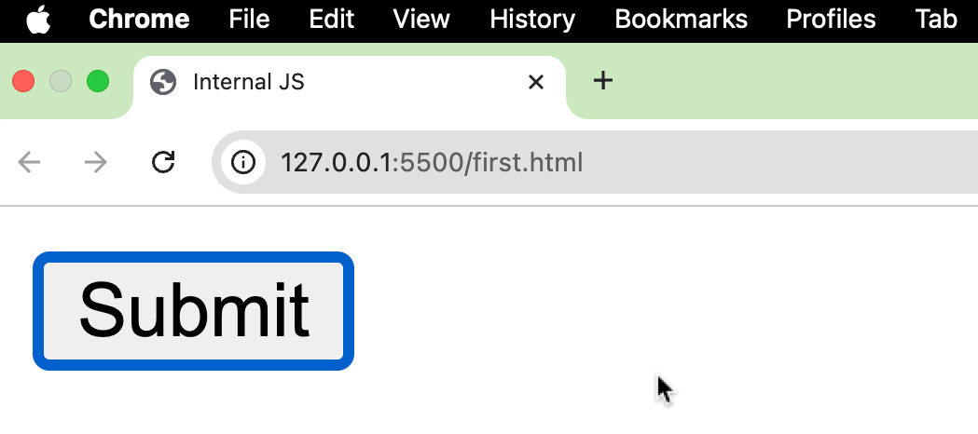
QN 1 Write a Js Program to demonstrate Internal Javascript
/*HTML code Save it as index1.html*/
<html>
<head> <title>Internal JS</title>
<script>
function adish() {
alert("Hello World")
}
</script>
</head>
<body>
<input type = "button" onclick = "adish()" value = "Submit" />
</body>
</html>

Slide 5
QN 2 Write a Js Program to demonstrate External Javascript
/*HTML code Save it as index2.html*/
<html>
<head> <title>External JS</title>
<script src="index2.js">
</script>
</head>
<body>
<input type = "button" onclick = "adish()" value = "Submit" />
</body>
</html>
/*Js code Save it as index2.js*/
function adish() {
alert("Hello World")
}

Slide 6
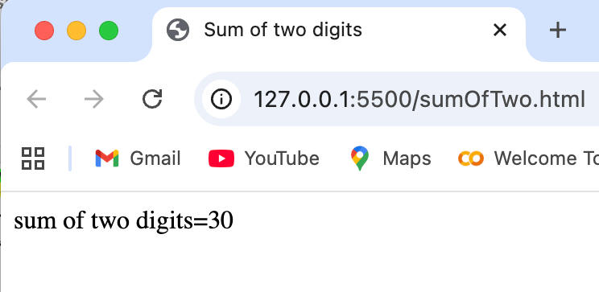
QN 3 Write a Js Program to demonstrate addition of two no:
<html>
<head>
<title>Sum of two digits</title>
</head>
<body>
<script>
var x = 10;
var y = 20;
var z=x+y;
document.write("sum of two digits="+z);
</script>
</body>
</html>

Slide 7
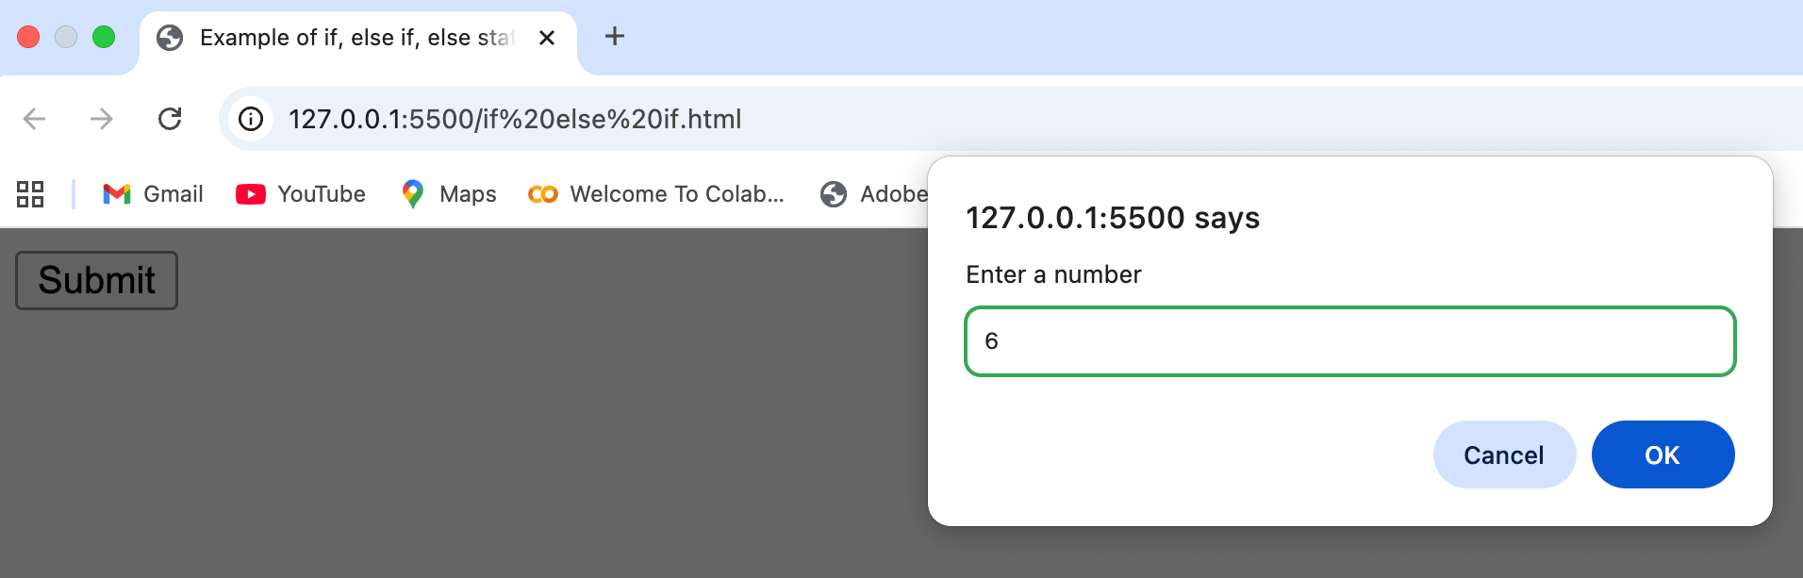
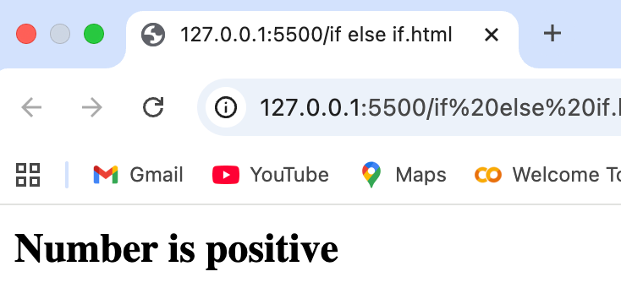
QN 4Write a Js Program to demonstrate an example of control statement using if(), elseif() and else statement.
<html>
<head>
<title> Example of if, else if, else statement</title>
<script>
function pnz()
{var num=parseInt(prompt("Enter a number"));
if(num <0)
document.write("<b>Number is negative</b>");
else if(num>0)
document.write("<b>Number is positive</b>");
else
document.write("<b>Number is zero</b>");
}
</script>
</head>
<body>
<input type = "button" onclick = "pnz()" value = "Submit" />
</body>
</html>

Slide 8
QN 5 Write a Js Program to demonstrate an example of menu based program using switch case statement.
case 5:
document.write("Thursday");
break;
case 6:
document.write("Friday");
break;
case 7:
document.write("Saturday");
break;
default: document.write("invalid day Please choose from 1-7");
break;
}
}
</script>
</head>
<body>
<input type="button" value="day" onclick=”menu()">
</body>
</html>
<html>
<head>
<title> example menu based program using switch case</title>
<script>
function menu()
{var day=parseInt(prompt("enter the day"));
switch(day)
{
case 1:
document.write("Sunday");
break;
case 2:
document.write("Monday");
break;
case 3:
document.write("Tuesday");
break;
case 4:
document.write("Wednesday");
break;

Slide 9
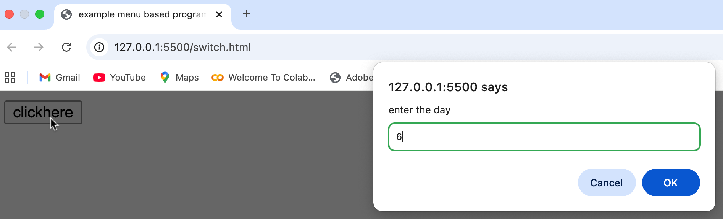
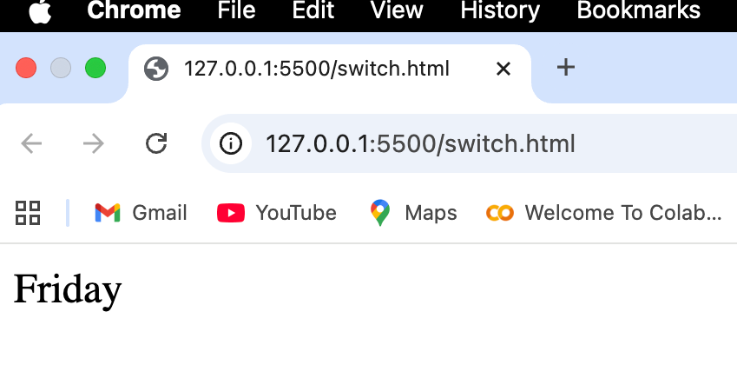
Output of Q 5

Slide 10
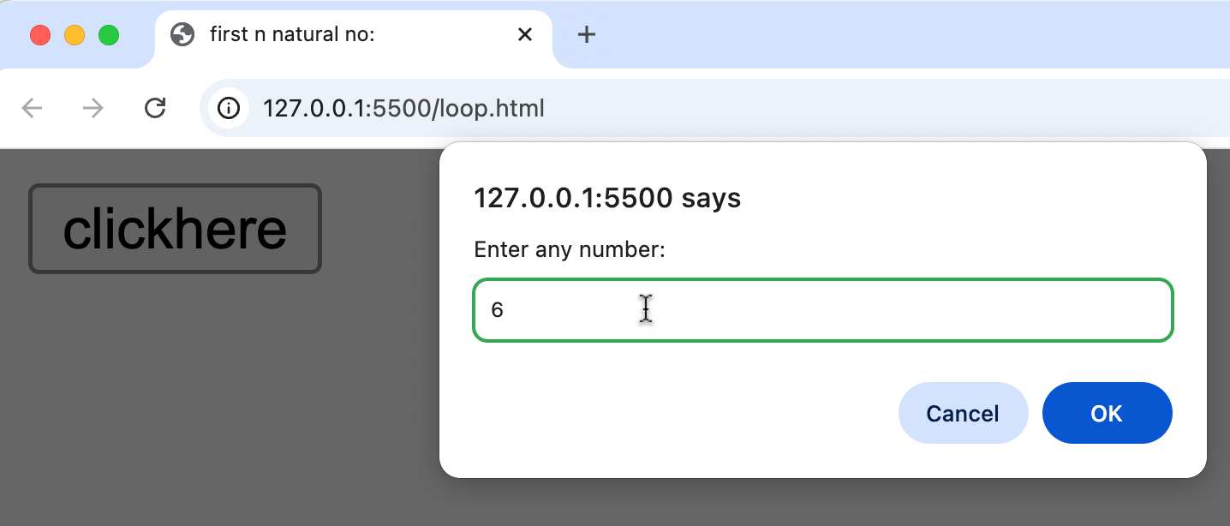
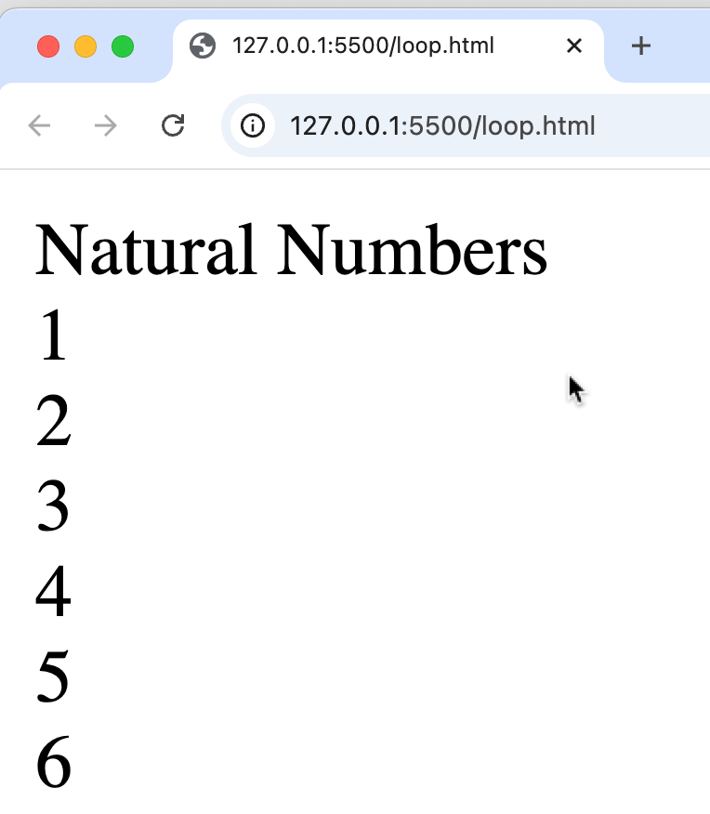
QN 6 Write a Js Program to demonstrate an example of loop to demonstrate first ‘n’ natural no.
<html>
<head>
<title> example to print first n natural no:</title>
<script>
function natural()
{ var i;
var n=parseInt(prompt("enter the number"));
for (i=1; i<=n; i++)
{
document.write(i + "<br/>");
}
}
</script>
</head>
<body>
<input type="button" value="clickhere" onclick="natural()">
</body>
</html>

Slide 11
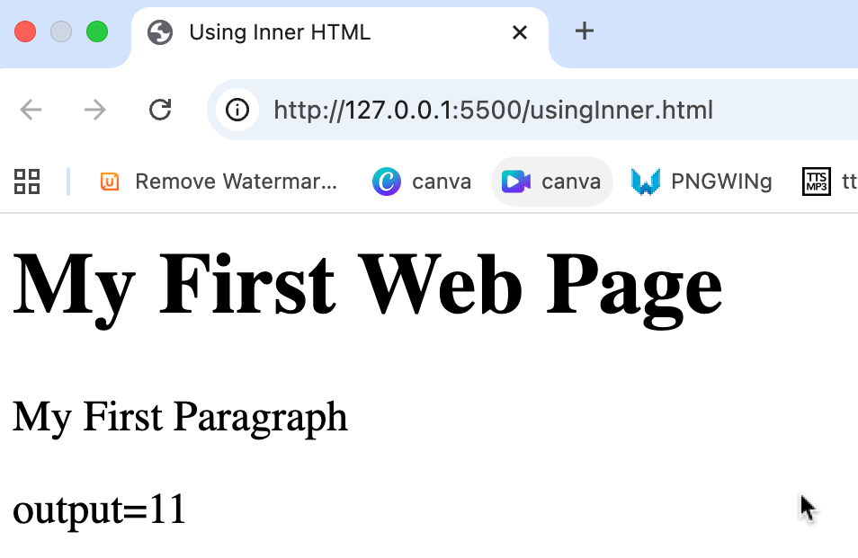
QN 7 Write a Js Program to demonstrate an example of addition of two no:using inner.HTML.
<html>
<head>
<title>Example of getElementById</title>
</head>
<body>
<p>Welcome to Arunima</p>
<p id="demo">?????</p>
<script>
function abc() {
document.getElementById("demo").innerHTML = "output=" + (5 + 6);
}
</script>
<input type="button" value="click" onclick="abc()">
</body>
</html>

Slide 12
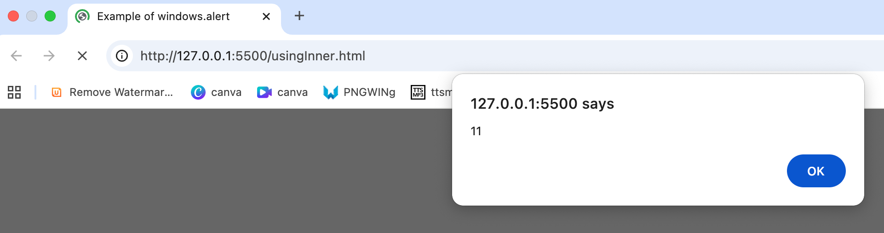
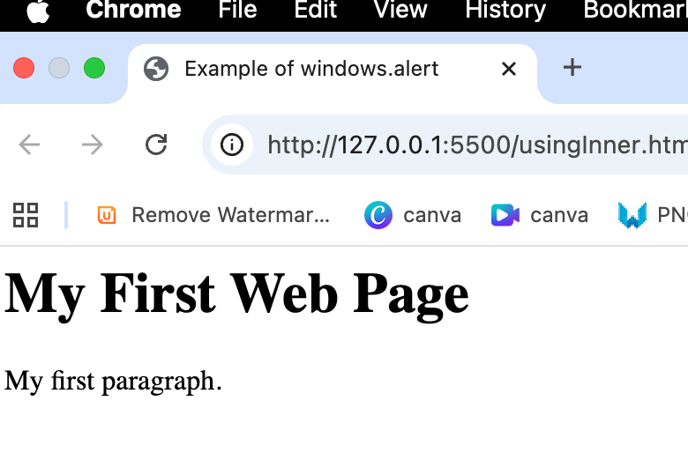
QN 8 Write a Js Program to demonstrate an example of addition of two no:using windows.alert
<html>
<head><title>Example of windows.alert</title></head>
<body>
<h1>My First Web Page</h1>
<p>My first paragraph.</p>
<script>
alert(5 + 6);
</script>
</body>
</html>

Slide 13
QN 9 "Write a JS program to turn a bulb ON and OFF using document.getElementById()."
<html>
<head>
<title>Bulb OnOff using document.getElementById</title>
</head>
<body>
<h2>What Can JavaScript Do?</h2>
<p>JavaScript can change HTML attribute values.</p>
<p>JavaScript changes the value of the src (source) attribute of an image.</p> <button onclick="document.getElementById('myImage').src='pic_bulbon.gif'"> Turn on the light
</button>
<img id="myImage" src="pic_bulboff.gif" style="width:100px">
<button onclick="document.getElementById('myImage').src='pic_bulboff.gif'"> Turn off the light
</button>
</body>
</html>

Slide 14
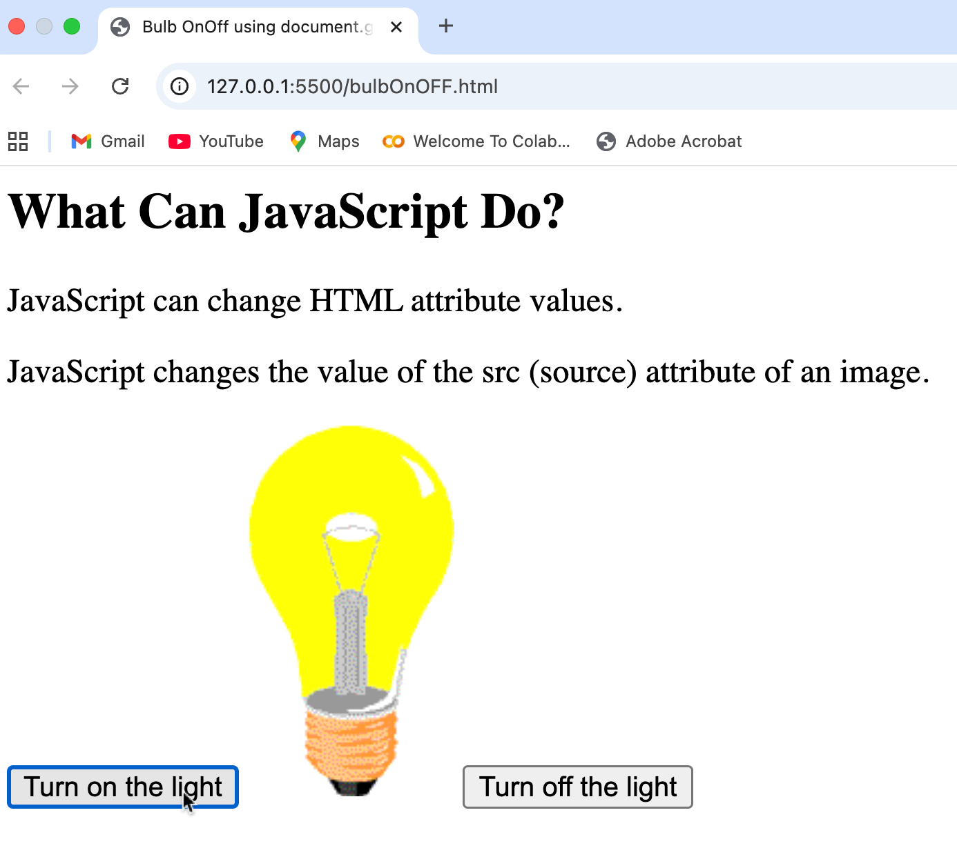
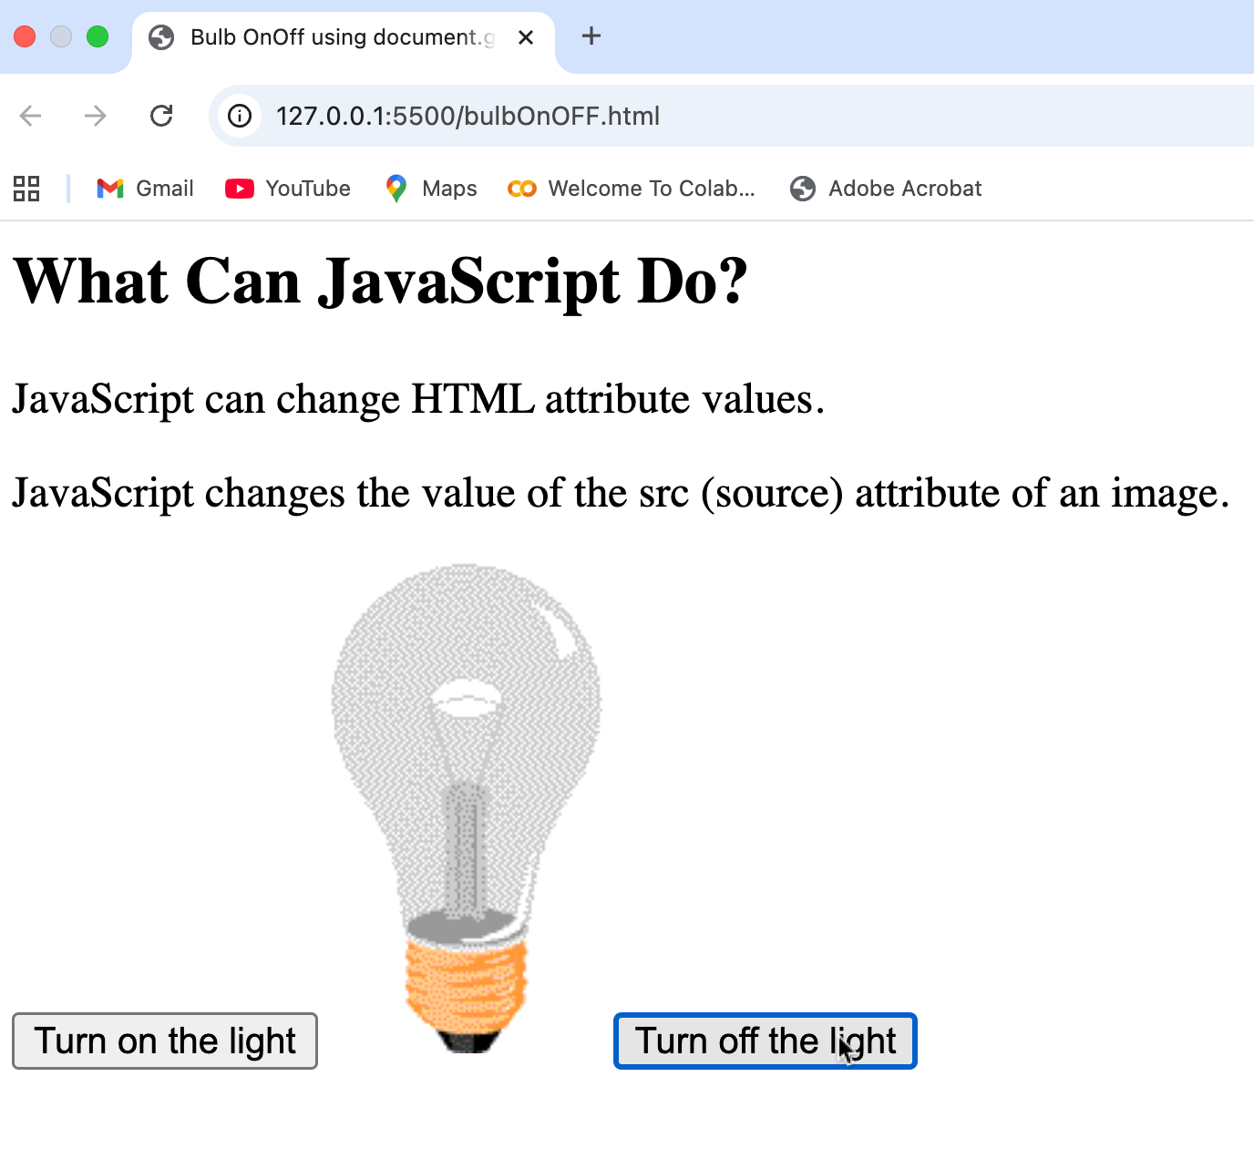
Output of Qn 9

Slide 15
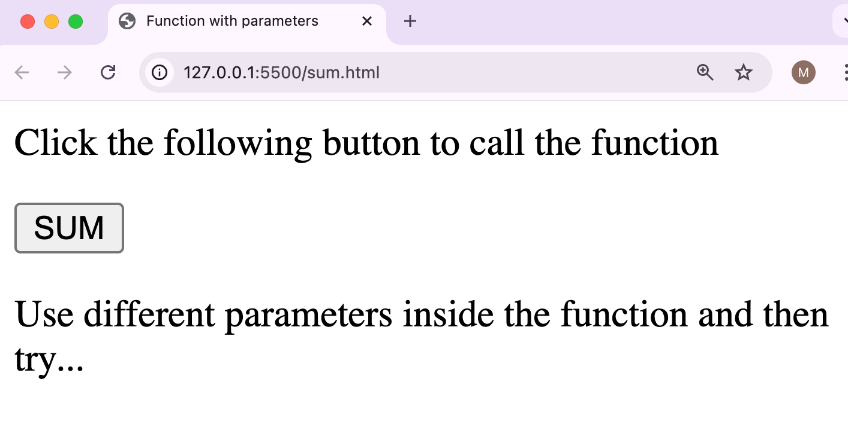
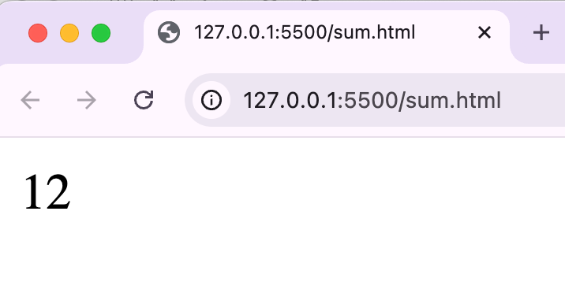
10.Write a JS program to add two numbers using a function with parameters.”
<html>
<head><title>Function with parameters</title>
<script>
function sayHello(a,b) {
var sum;
sum = a+b;
document.write (sum);
}
</script>
</head>
<body>
<p>Click the following button to call the function</p>
<form>
<input type = "button" onclick = "sayHello(5,7)" value = "SUM">
</form>
<p>Use different parameters inside the function and then try...</p>
</body>
</html>

Slide 16
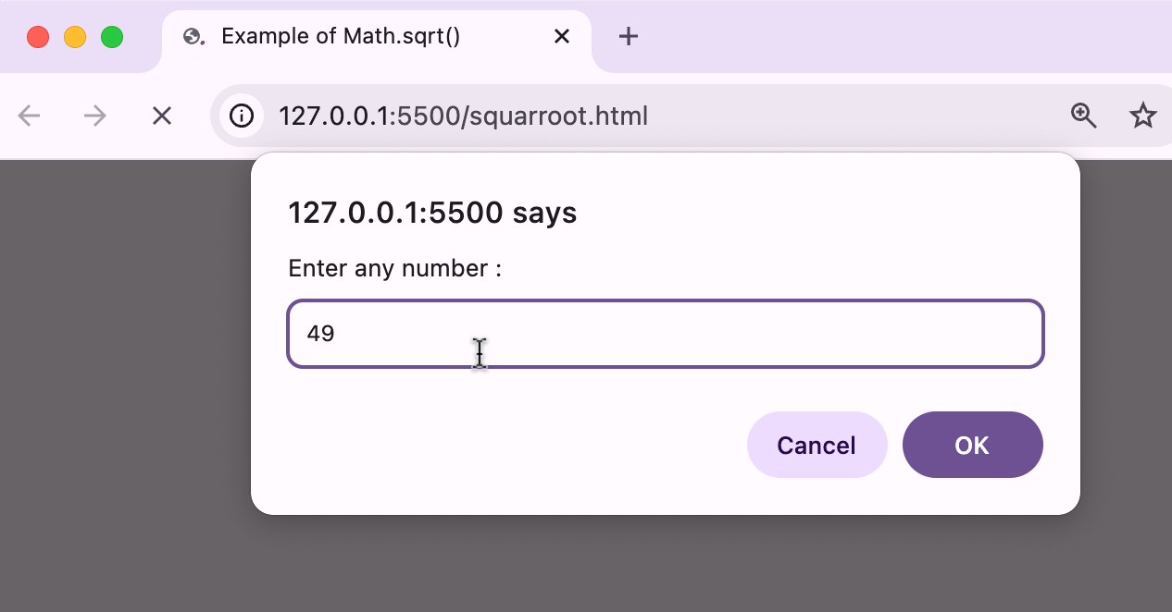
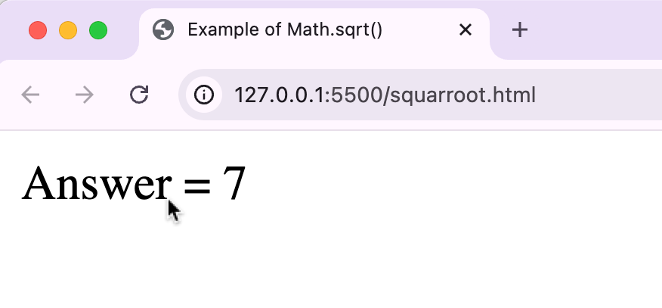
11.Write a JS program to find the square root of a number using Math.sqrt()<html>
<head>
<title>Example of Math.sqrt()</title>
</head>
<body>
<script>
var num, sqr;
num=parseInt(prompt("Enter any number : "));
sqr=Math.sqrt(num);
document.write ("Answer = "+sqr);
</script>
</body>
</html>

Slide 17
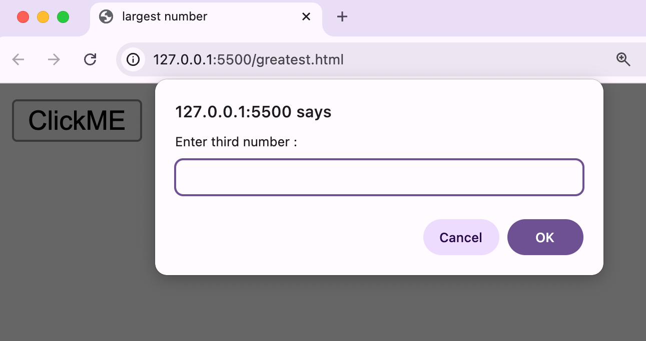
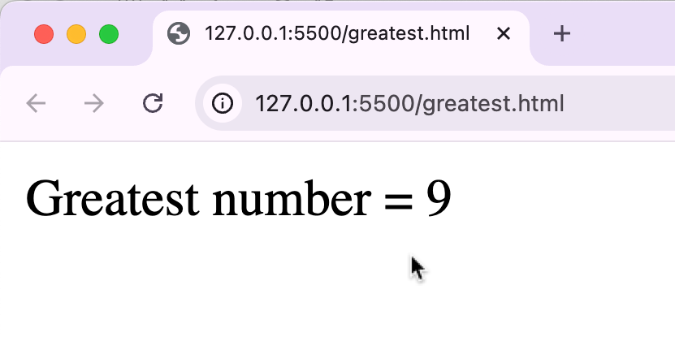
12. Write a JS program to find the greatest no: among three number
<html>
<head> <title>largest number</title>
</head>
<body>
<script>
function largest()
{var num1,num2,num3;
num1=parseInt(prompt("Enter first number : "));
num2=parseInt(prompt("Enter second number : "));
num3=parseInt(prompt("Enter third number : "));
if(num1>num2 && num1>num3)
document.write (" Greatest number = "+num1);
else if(num2>num3)
document.write (" Greatest number = "+num2);
else
document.write (" Greatest number = "+num3);
}
</script>
<input type="button" value="ClickME" onclick="largest()"/>
</body>
</html>

Slide 18
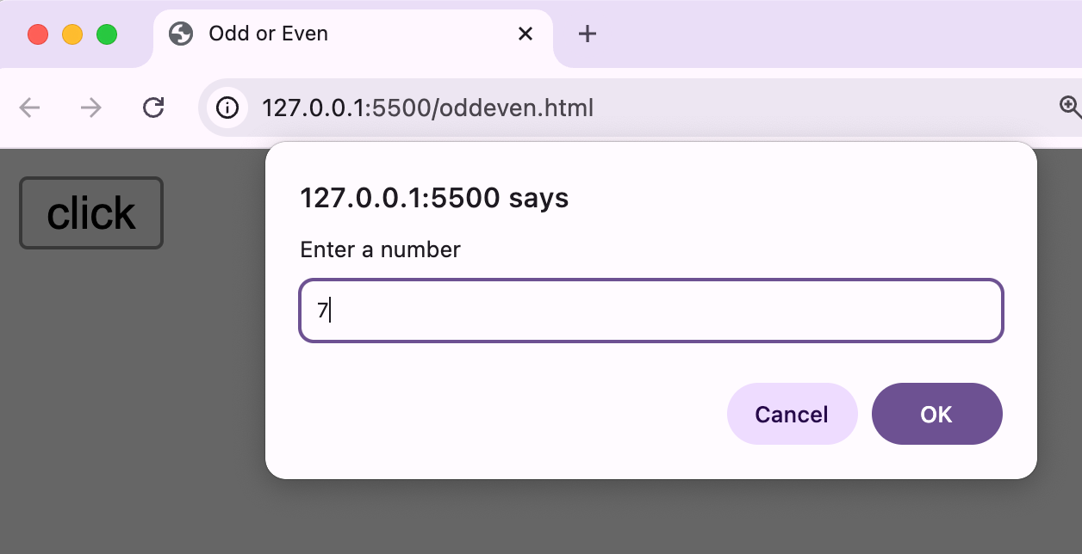
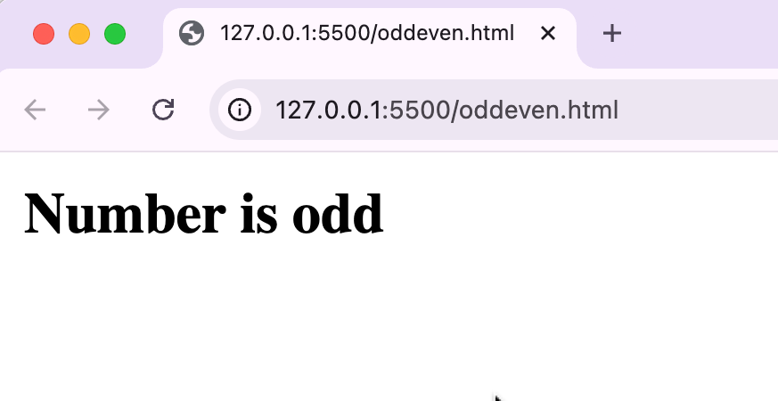
13. Write a JS program to find odd or Even
<html>
<head>
<title>Odd or Even</title>
<script>
function oddEven()
{
var num=parseInt(prompt("Enter a number"));
if(num%2==0)
document.write("<b>Number is even</b>");
else
document.write("<b>Number is odd</b>");
}
</script>
<body>
<input type="button" value="click" onclick="oddEven()">
</body>
</body>
</html>

Slide 19
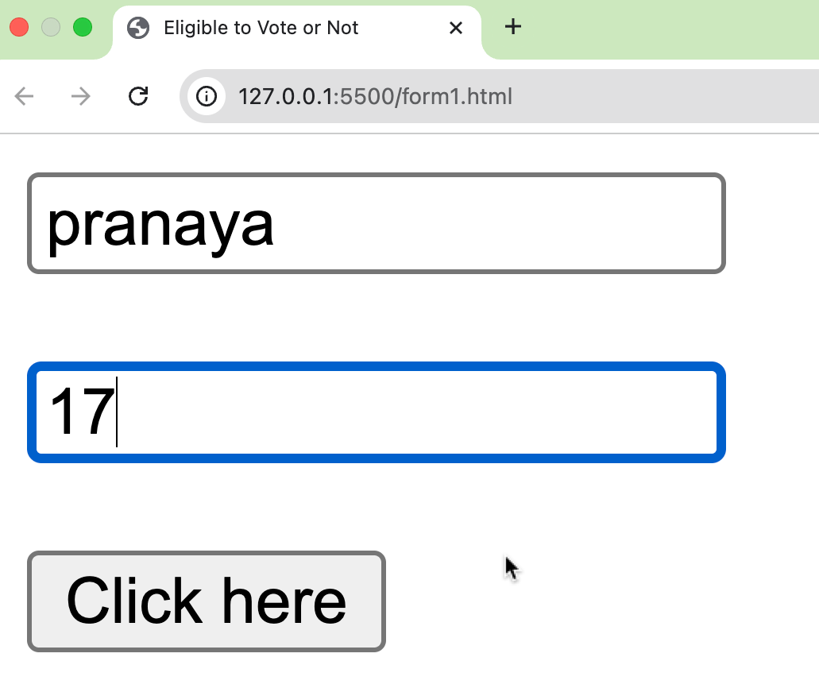
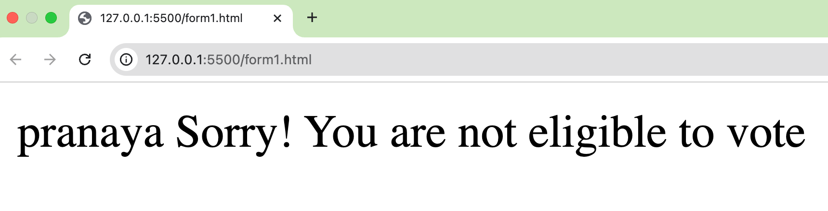
14. Write a JS program to check whether the age is eligible to vote or not
<html> <head>
<title>Eligible to Vote or Not</title>
<script>
function test() {
var naam = document.myForm.uname.value; // Or you can use document.getElementById(" uname ").value
var a = document.myForm.age.value;
if (a >= 18)
document.write(naam + " You are eligible to vote ");
else
document.write(naam + " Sorry! You are not eligible to vote");
}
</script> <body>
<form name="myForm">
<input type="text" name="uname" placeholder="Enter name">
<br><br>
<input type="text" name="age" placeholder="Enter age">
<br><br>
<input type="button" value="Click here" onclick="test()">
</form> </body> </html>

Slide 20
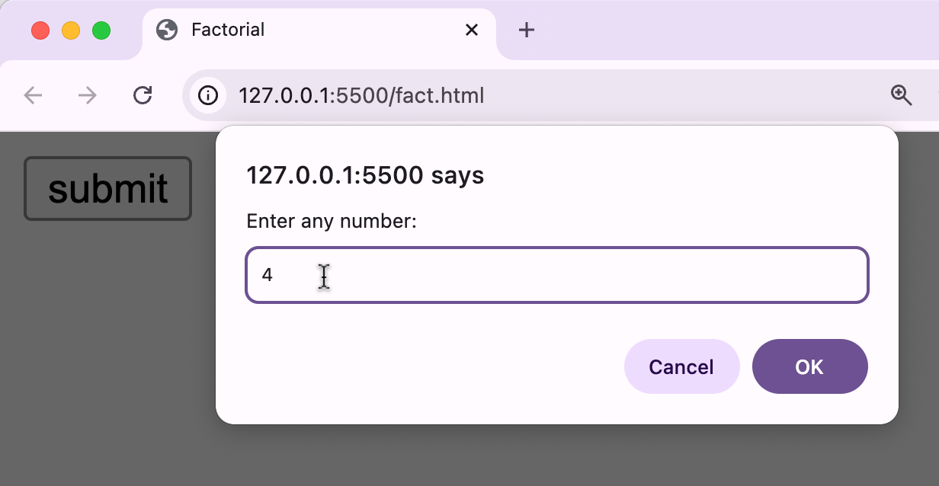
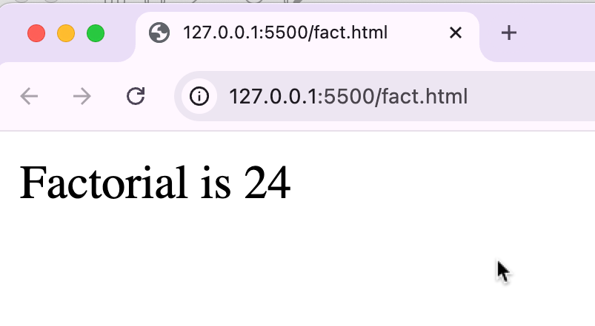
15. Write a JS program to find factorial of “n” number
<html>
<head>
<title>Factorial</title>
<script>
function fact()
{
var num, i, f = 1;
num = parseInt(prompt("Enter any number: "));
for (i = 1; i <= num; i++) {
f = f * i;
}
document.write("Factorial is " + f);
}
</script>
</head>
<body>
<input type="button" value="submit" onclick="fact()">
</body>
</html>

Slide 21
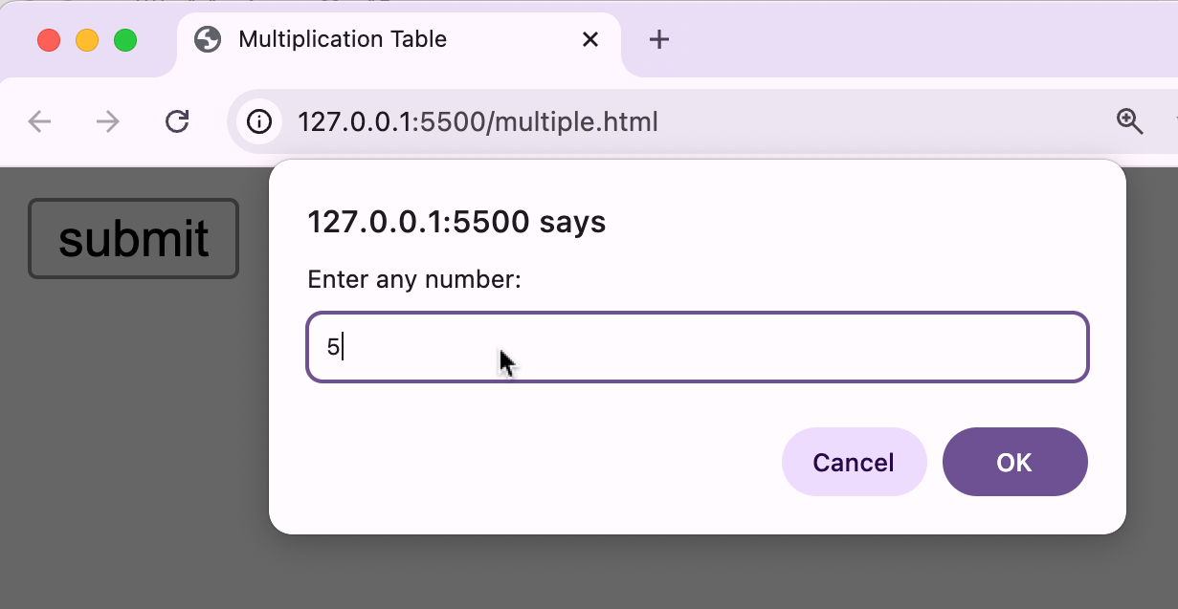
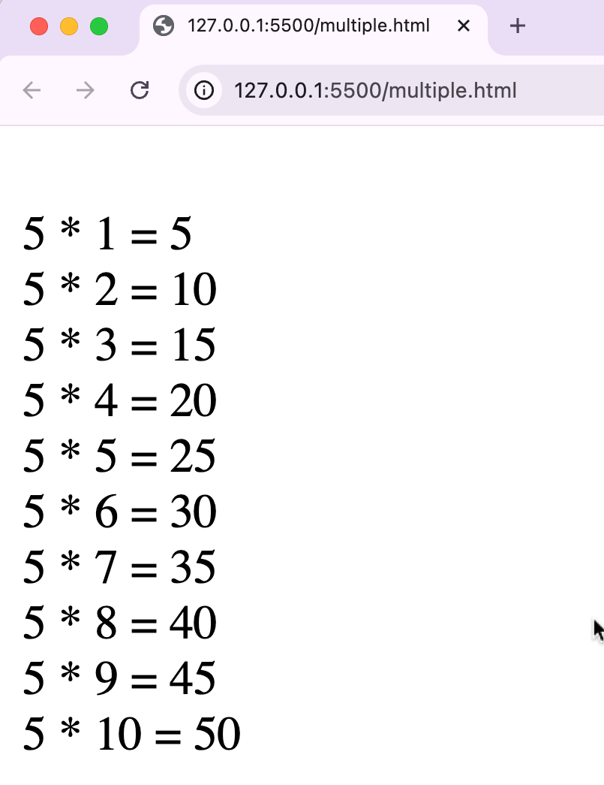
16. Write a JS program to find multiple of “n” number
<html>
<head>
<title>Multiplication Table</title>
<script>
function table() {
var num, i;
num = parseInt(prompt("Enter any number: "));
for (i = 1; i <= 10; i++)
{
m = num * i;
document.write("<br>"+num+" * "+i+" = "+m);
}
}
</script>
</head>
<body>
<input type="button" value="submit" onclick="table()">
</body>
</html>

Slide 22
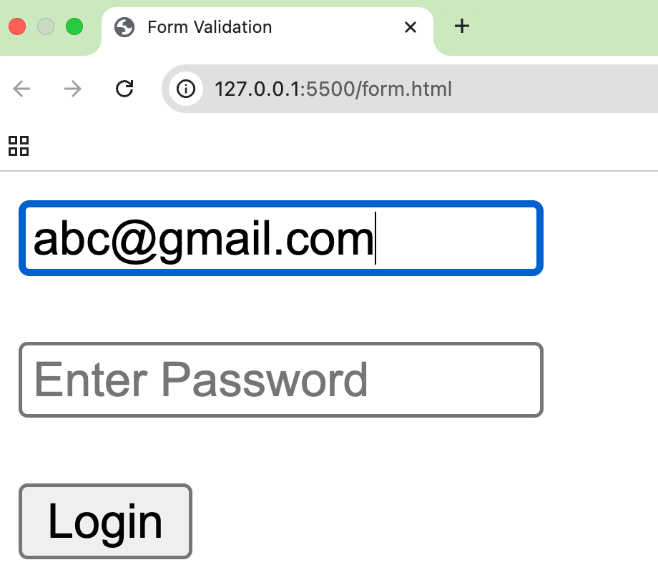
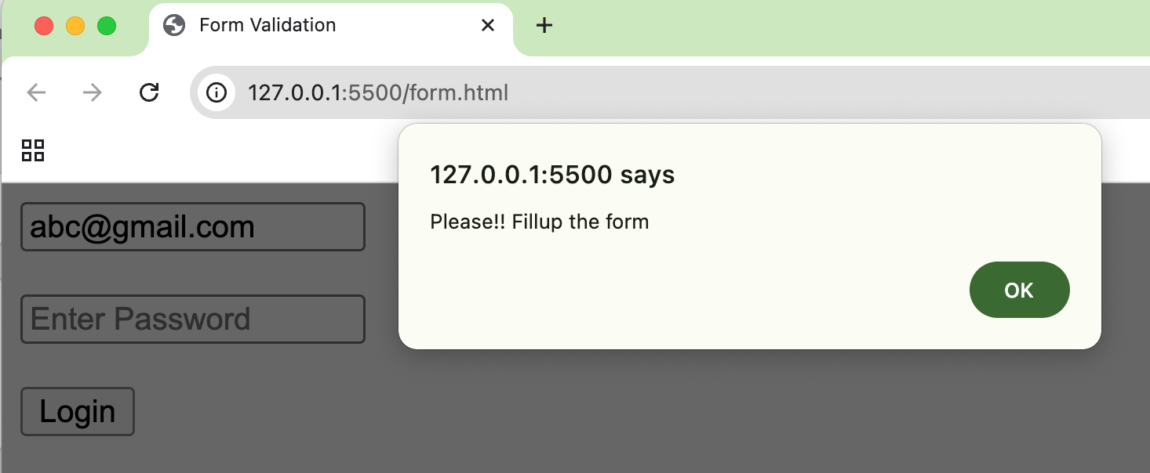
17. Write a JavaScript program to validate an HTML form using getElementById() and show an alert when any field is blank.”
<html>
<head>
<title>Form Validation</title>
<script>
function valid()
{
var u=document.getElementById("user").value;
var p=document.getElementById("pass").value;
if(u==""||p=="")
{
alert("Please!! Fillup the form");
}
}
</script>
</head>
<body>
<form>
<input type="email" id="user" placeholder="Enter Email">
<br><br>
<input type="password" id="pass" placeholder="Enter Password">
<br><br>
<input type="submit" onclick="valid()" value="Login">
</form>
</body>
</html>

Slide 23
JQuery

Slide 24
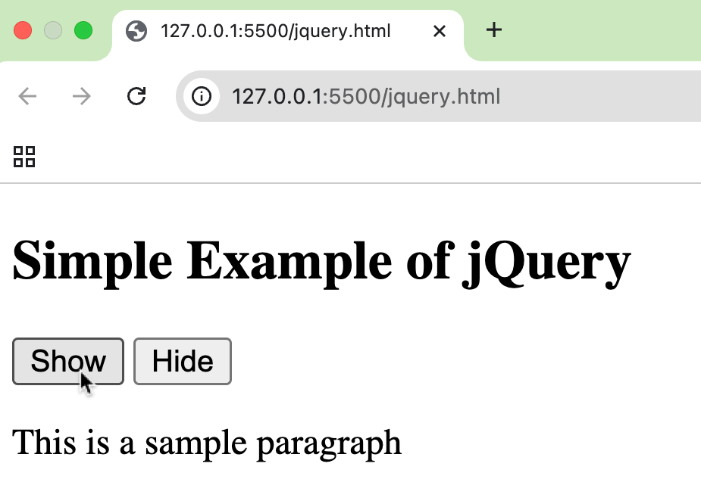
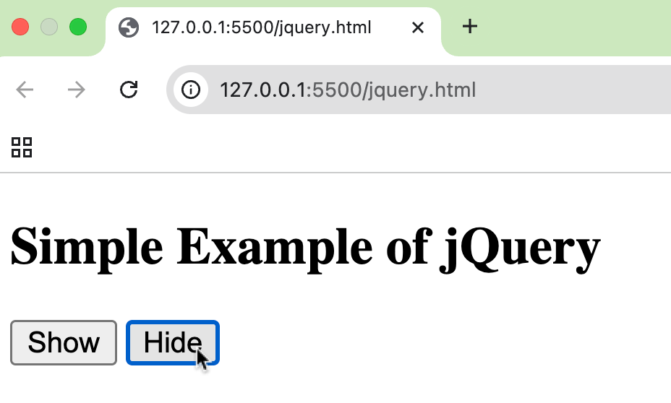
18.Write a jQuery program to show and hide a paragraph when the user clicks the ‘Show’ and ‘Hide’ buttons.
<!DOCTYPE html>
<html> <head>
<script src="jquery.min.js"> </script>
<script>
$(document).ready(function () {
$(".sh").click(function () {
$(".content").show();
});
$(".hd").click(function () {
$(".content").hide();
});
});
</script>
</head> <body>
<h2> Simple Example of jQuery </h2>
<button class="sh">Show </button>
<button class="hd">Hide </button>
<p class="content"> This is a sample paragraph </p>
</body> </html>

Slide 25
PHP

Slide 26
PHP
The PHP Hypertext Preprocessor (PHP) is a programming language that allows web developers to create dynamic content that interacts with databases. PHP is basically used for developing web-based software applications. PHP started out as a small open-source project that evolved as more and more people found out how useful it was. Rasmus Lerdorf unleashed the first version of PHP way back in 1994.
• PHP is a recursive acronym for "PHP: Hypertext Preprocessor".
• PHP is a server-side scripting language that is embedded in HTML. It is used to manage dynamic content, databases, session tracking, even build entire e-commerce sites.
• It is integrated with a number of popular databases, including MySQL, PostgreSQL, Oracle, Sybase, Informix, and Microsoft SQL Server.

Slide 27
PHP
Characteristics of PHP
Five important characteristics make PHP's practical nature possible −
• Simplicity
• Efficiency
• Security
• Flexibility
• Familiarity
Example:
<html>
<head>
<title>This is my first php page. </title>
</head>
<body>
<?php echo "Hello world"; ?>
</body>
</html>

Slide 28
PHP
Control Statement
Control statements are conditional statements that execute a block of statements if the condition is correct. The statement inside the conditional block will not execute until the condition is satisfied. Types
1. if..........else
if($var="DAYA")
{
echo "Your name is DAYA";
}else{
echo "You are not DAYA";
}
2. switch case
switch case($var)
{
case 1:
echo "Sunday";
break;
case 2:
echo "Monday";
break;
default:
echo "No case match";
}
3. ternary
($var=="DAYA") ? "Your name is DAYA" : "You are not DAYA";

Slide 29
PHP
Looping/Iteration
Loops are mainly used to repeat the process until the conditions are met. Until the conditions are met the loops repeatedly execute. If the condition is not met, the loop will execute an infinite number of times.
Types
1. For loop
for($var=1; $var<=10; $var++)
{ echo $var;
}
2. While loop
$var=1;
while($var<=10)
{ echo $var;
$var++;
}
3. Do...... While loop
$var=1;
do
{ echo $var;
$var++
} while($var<10);
4. For each loop
foreach(array as key => value)
{ statement;
}

Slide 30
PHP
Operators
Operators are used to perform operations on variables and values.
PHP divides the operators in the following groups:
➢ Arithmetic operators
➢ Assignment operators
➢ Comparison operators
➢ Increment/Decrement operators
➢ Logical operators
➢ String operators
➢ Array operators
➢ Conditional assignment operators

Slide 31
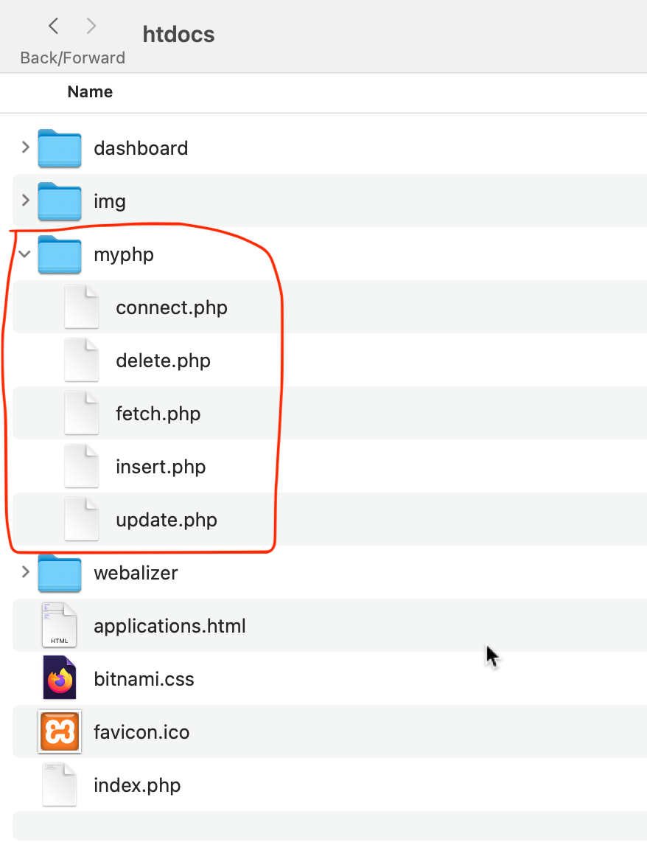

Slide 32
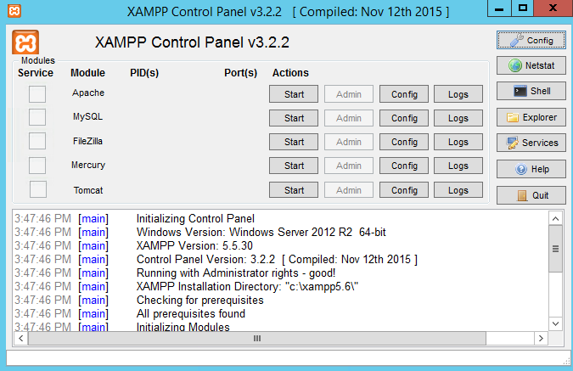


Click here

Slide 33
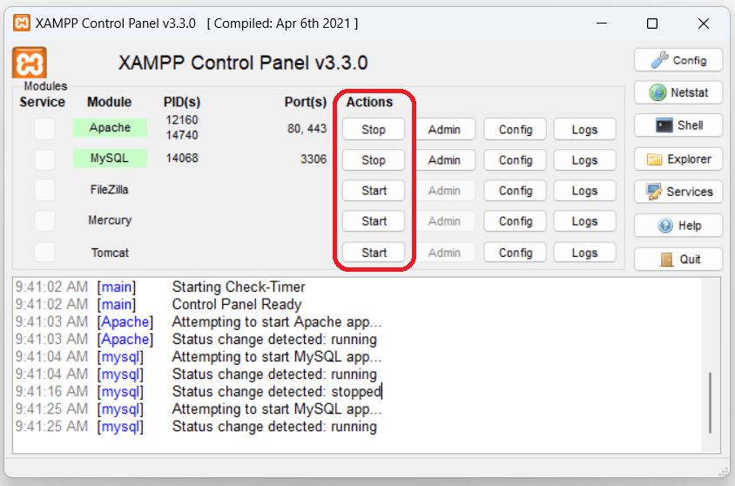
Click here

Slide 34
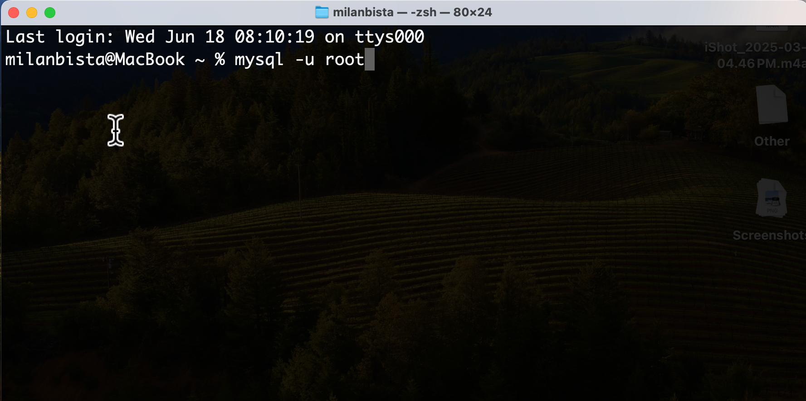
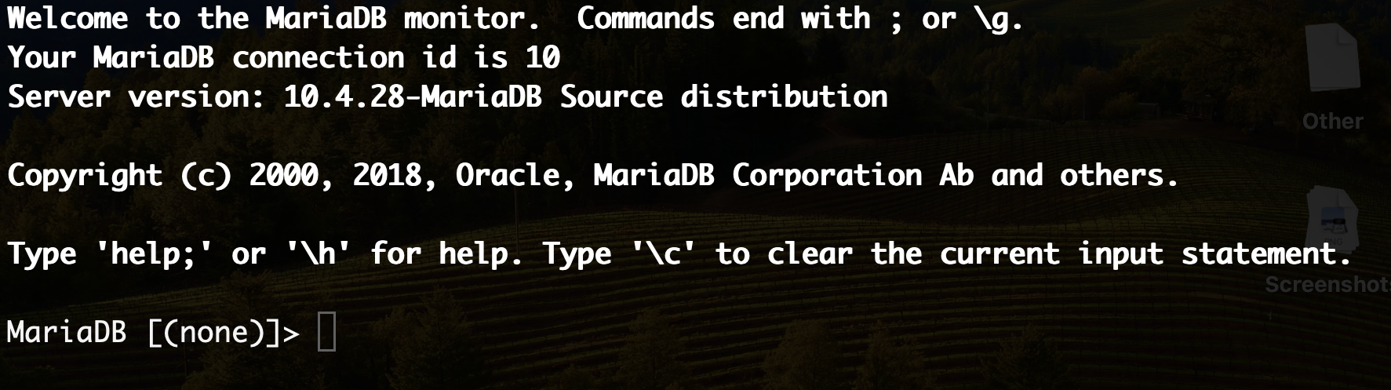
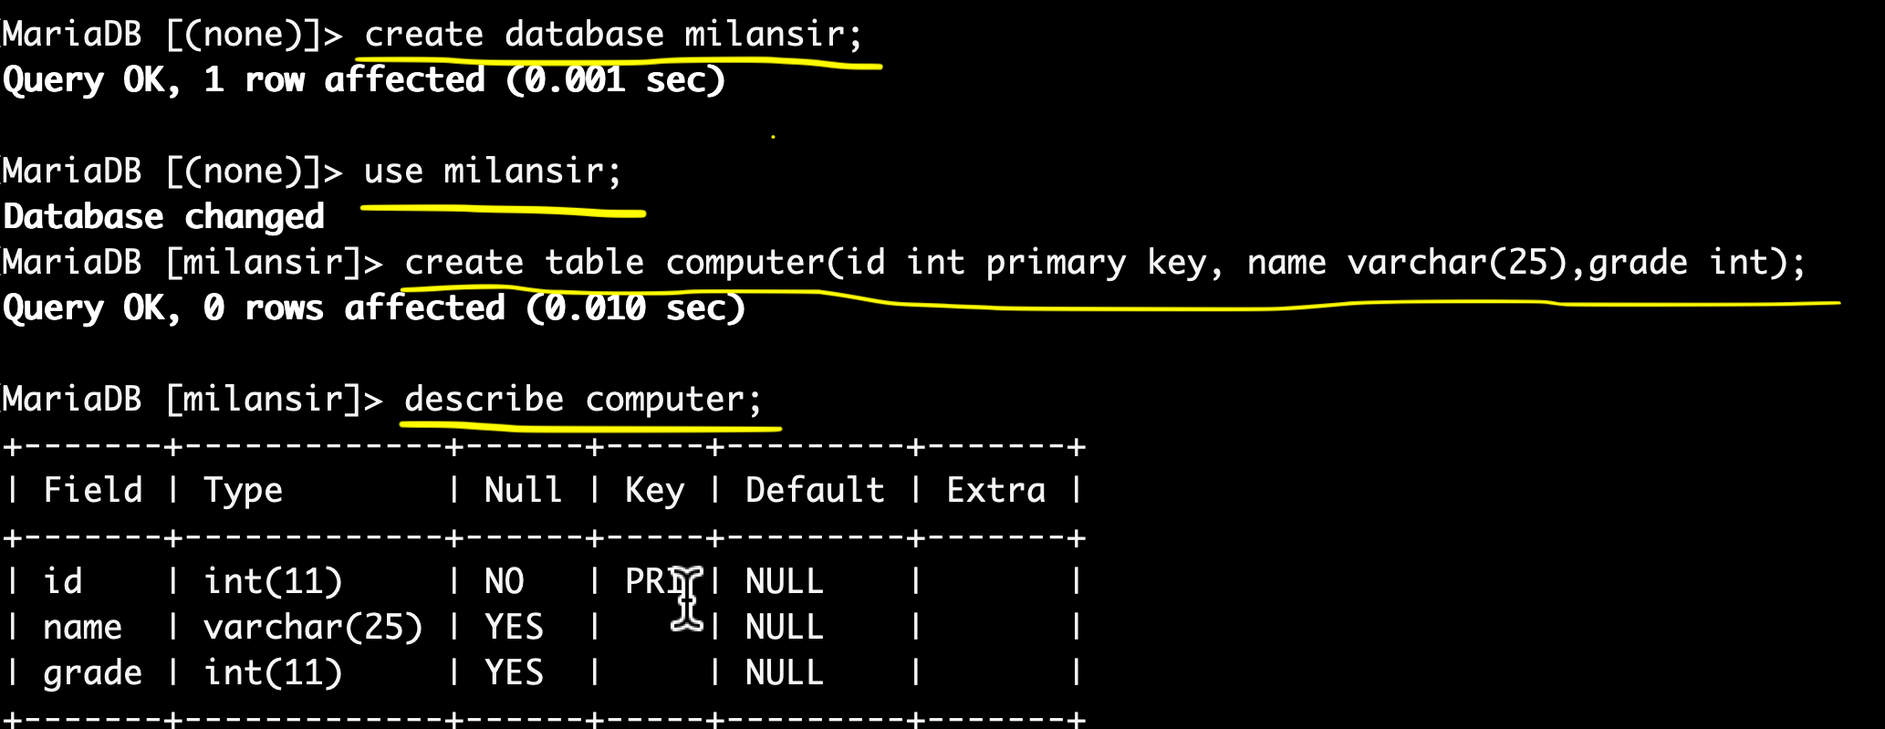


Slide 35
NOTE: create a folder name myphp under xammp/htdocs
create a file name connect.php under folder myphp
create a file name insert.php under folder myphp
create a file name fetch.php under folder myphp
create a file name update.php under folder myphp
create a file name delete.php under folder myphp

Slide 36
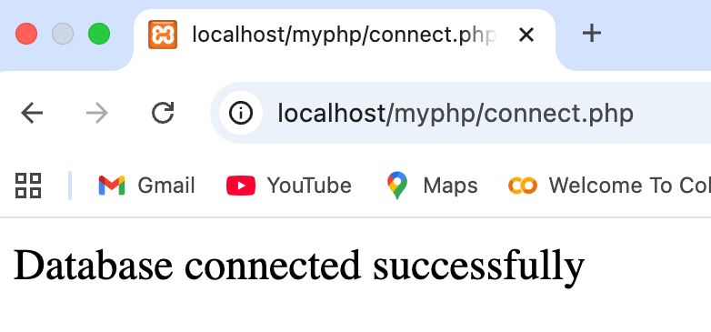
1. Write a PHP program to connect a database named ‘milansir’.
<?php
$servername = "localhost";
$username = "root";
$password = "";
$dbname = "milansir";
$conn = new mysqli($servername, $username, $password, $dbname);
if ($conn->connect_error) {
die("Connection failed: " . $conn->connect_error);
} else {
echo "Database connected successfully";
}
?>
In Chrome

Slide 37
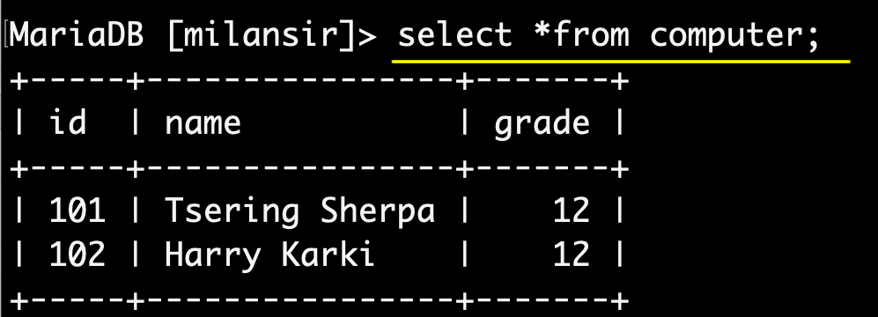
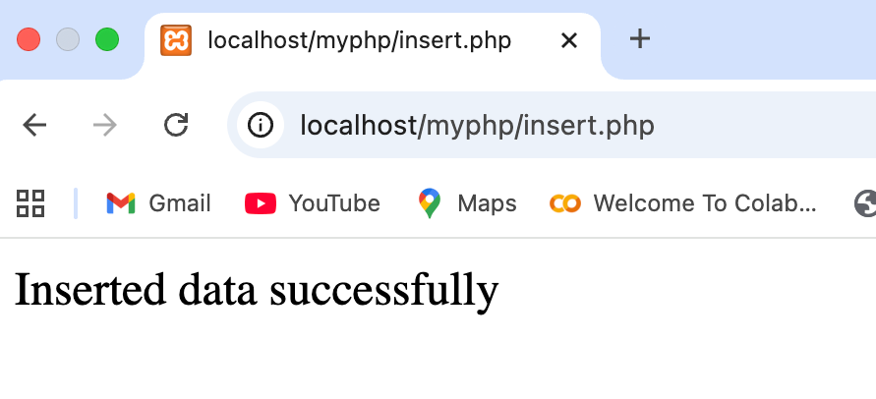
2. Write a PHP program to insert records in a table named ‘computer’ with fields id, name and grade in a database named ‘milansir’.
<?php
$servername = "localhost";
$username = "root";
$password = "";
$dbname = "milansir";
$conn = new mysqli($servername, $username, $password, $dbname);
if($conn->connect_error){
die("Connection failed:".mysqli_connect_error());
}
$sql = "INSERT INTO computer (id, name, grade)VALUES (101, 'Tsering Sherpa', 12),(102, 'Harry Karki', 12)";
if ($conn->query($sql) === TRUE) {
echo "Inserted data successfully";
} else {
echo "Error in inserting data: " . $conn->error;
}
$conn->close();
?>
OUTPUT
In Chrome

Slide 38
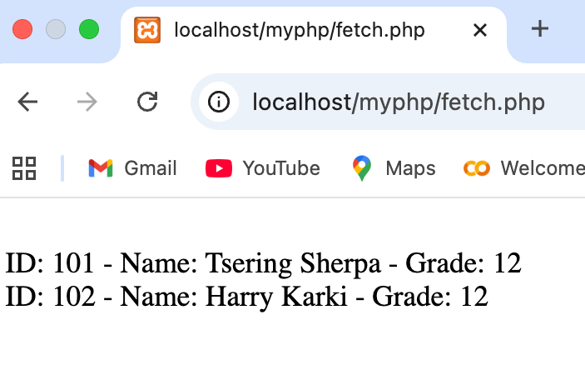
3. Write a PHP program to display all records of ‘computer’ who are in grade 12.
<?php
$servername = "localhost";
$username = "root";
$password = "";
$dbname = "milansir";
$conn = new mysqli($servername, $username, $password, $dbname);
if ($conn->connect_error) {
die("Connection failed: " . $conn->connect_error);
}
$sql = "SELECT * FROM computer WHERE grade = '12'";
$result = $conn->query($sql);
if ($result->num_rows > 0) {
while ($row = $result->fetch_assoc()) {
echo "<br> ID: " . $row["id"] .
" - Name: " . $row["name"] .
" - Grade: " . $row["grade"];
}
} else {
echo "0 results";
}
$conn->close();
?>
In Browser

Slide 39
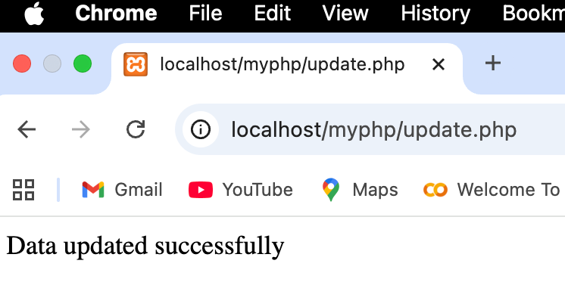
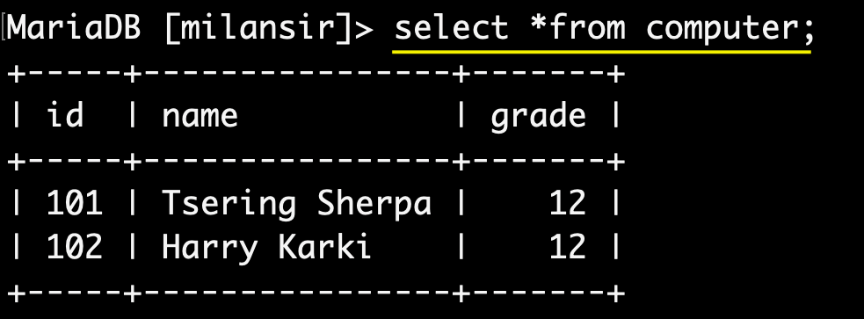
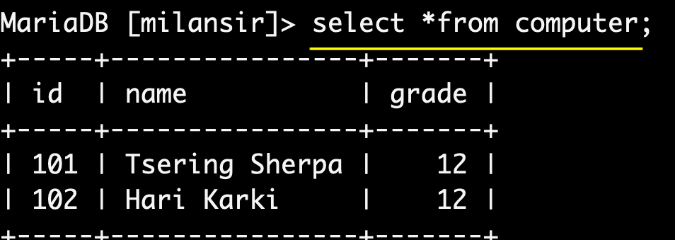
4. Write a PHP program to update a record (name/grade) of ‘computer’ whose id is 102.
<?php
$servername = "localhost";
$username = "root";
$password = "";
$dbname = "milansir";
$conn = new mysqli($servername, $username, $password, $dbname);
if ($conn->connect_error)
die("Connection failed:" . mysqli_connect_error());
$sql = "UPDATE computer SET name='Hari Karki' WHERE id=102;";
if ($conn->query($sql) === true) {
echo "Data updated successfully";
} else {
echo "Error in data update :" . $conn->error;
}
$conn->close();
?>
In Chrome
Before update
After update

Slide 40
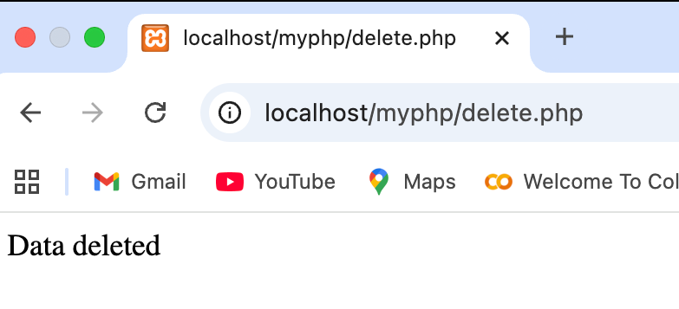
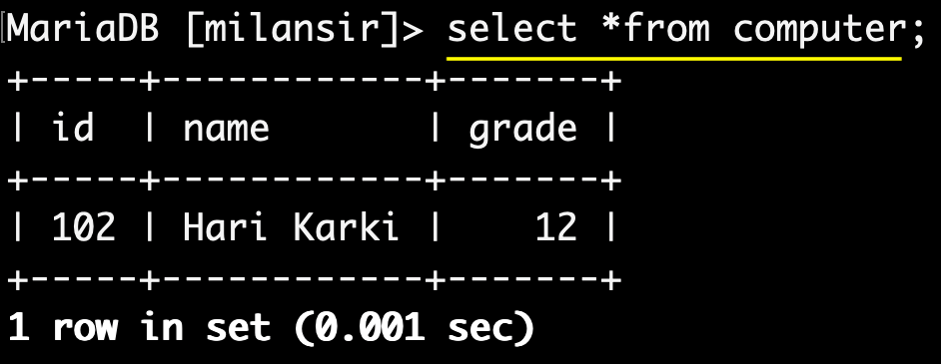
5. Write a PHP program to delete records of a “computer” whose id is 101 in a database named ‘milan sir’.
<?php
$servername = "localhost";
$username = "root";
$password = "";
$dbname = "milansir";
$conn = new mysqli($servername, $username, $password, $dbname);
if ($conn->connect_error)
die("Connection failed:" . mysqli_connect_error());
$sql = "DELETE FROM computer WHERE id=101";
if ($conn->query($sql) === true) {
echo "Data deleted ";
} else {
echo "Error in deleting data:" . $conn->error;
}
$conn->close();
?>
In Chrome
Before deleted
After deleted

Slide 41
Revision for second term 2082
Short Question from JavaScript
Write a JS program to find odd or Even of“n” number given by user
Write a JS program to find factorial of “n” numbergiven by user
Write a JS program to find multiple of “n” numbergiven by user
Write a Js Program to demonstrate an example of control statement using if(), elseif() and else statement.
Write a JS program to check whether the age is eligible to vote or not
Write a JavaScript program to validate an HTML form using getElementById() and show an alert when any field is blank.”
Differentiate between Server Side Scripted language and Client Side Scripted Language
Short Question from PHP
Write a PHP program to connect a database named ‘arunima’.
Write a PHP program to insert records in a table named ‘computer’ with fields id, name and grade in a database named ‘college’.
Write a PHP program to update a record (name/grade) of ‘computer’ whose id is 102.

Slide 42
THE END

